Slide 1
.Net Programming
Ngo Lam Trung
School of Information and Communication Technology
Office: 505-B1
E-mail: trungnl@soict.hust.edu.vn

Slide 2
Week 6: File I/O and Object Serialization
Regex
- System.IO namespace
- File/FileInfo and Directory/DirectoryInfo
- Stream/Reader/Writer
- Object serialization

Slide 3
Overview
Persisting data is a fundamental requirement
Writing to disk/mem data store
Reading from disk/mem data store
Data
String
Binary
Objects

Slide 4
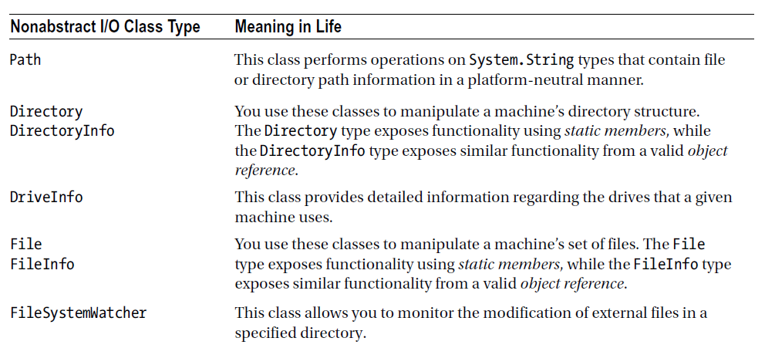
System.IO namespace

Slide 5
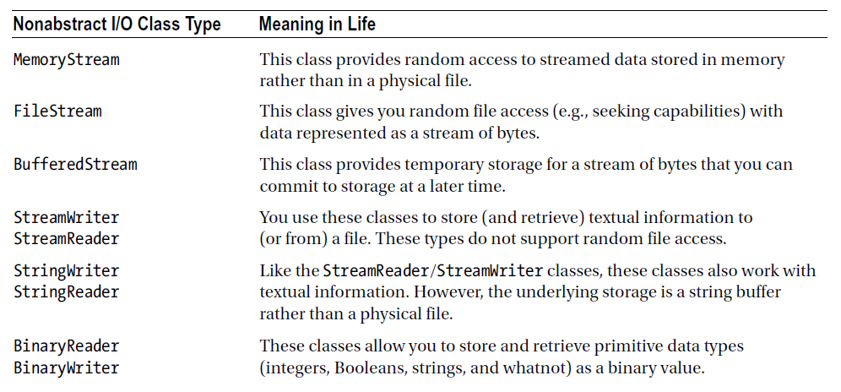
System.IO namespace

Slide 6
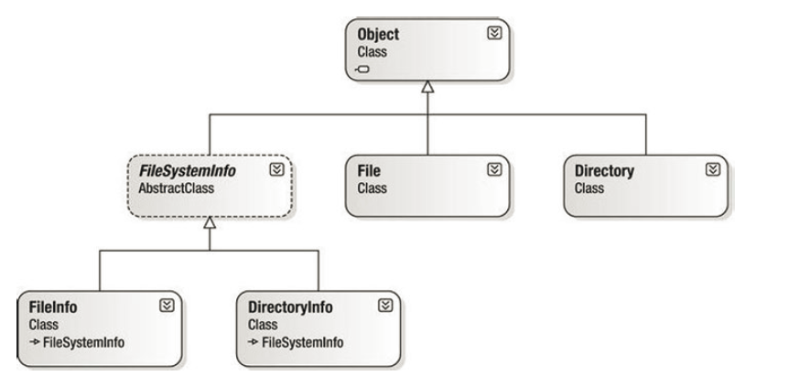
Manipulating files and directories
File/FileInfo
Directory/DirectoryInfo

Slide 7
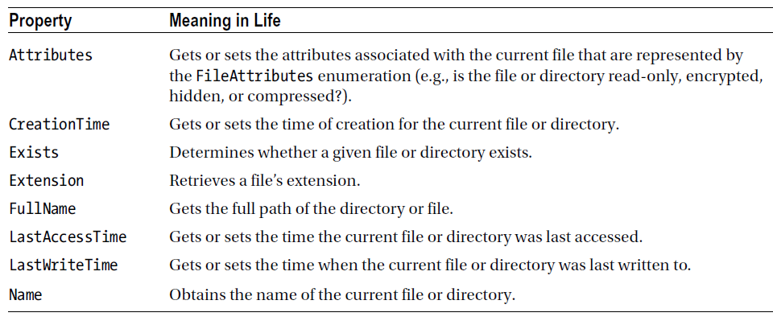
The abstract FileSystemInfo

Slide 8
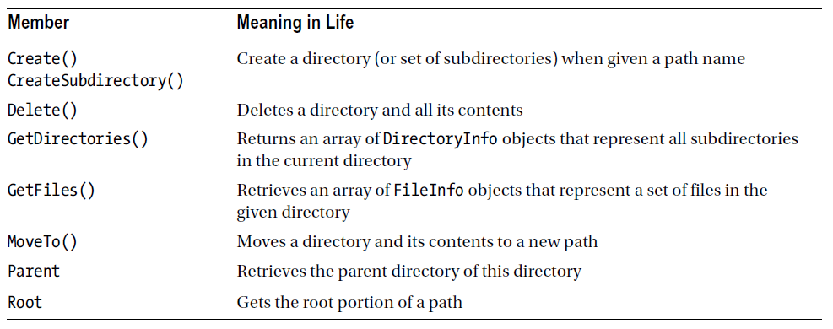
DirectoryInfo
Provides methods to manipulate directories

Slide 9
Usage
// Bind to the current working directory.
DirectoryInfo dir1 = new DirectoryInfo(".");
// Bind to C:\Windows,
DirectoryInfo dir2 = new DirectoryInfo(@"C:\Windows");
// Bind to a nonexistent directory, then create it.
DirectoryInfo dir3 = new
DirectoryInfo(@"C:\MyCode\Testing");
dir3.Create();

Slide 10
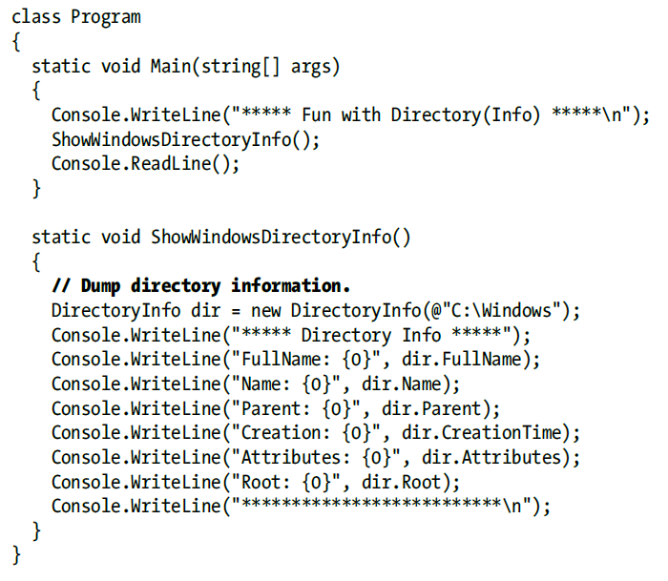
Sample 1

Slide 11
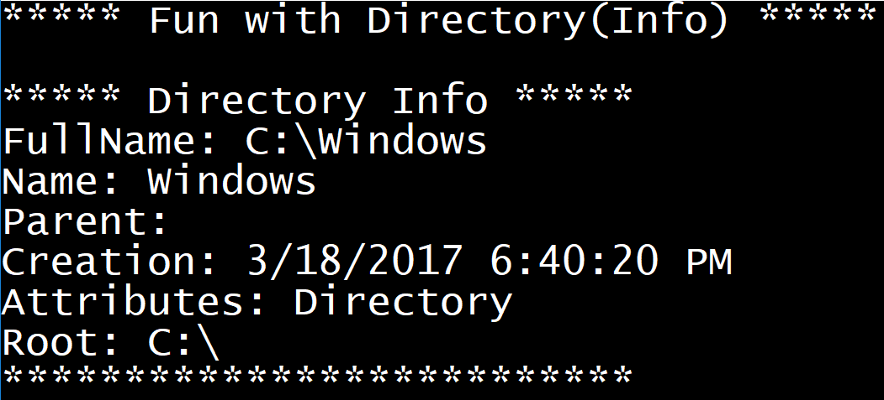
Sample 1 output

Slide 12
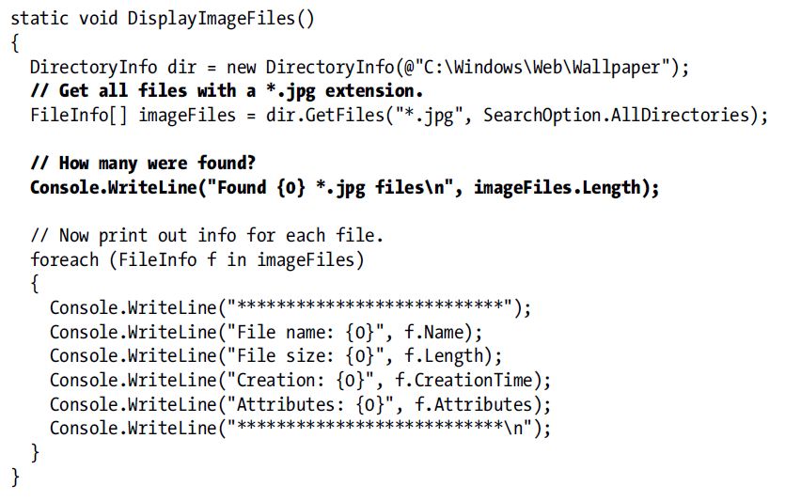
Sample 2: enumerating files and file properties

Slide 13
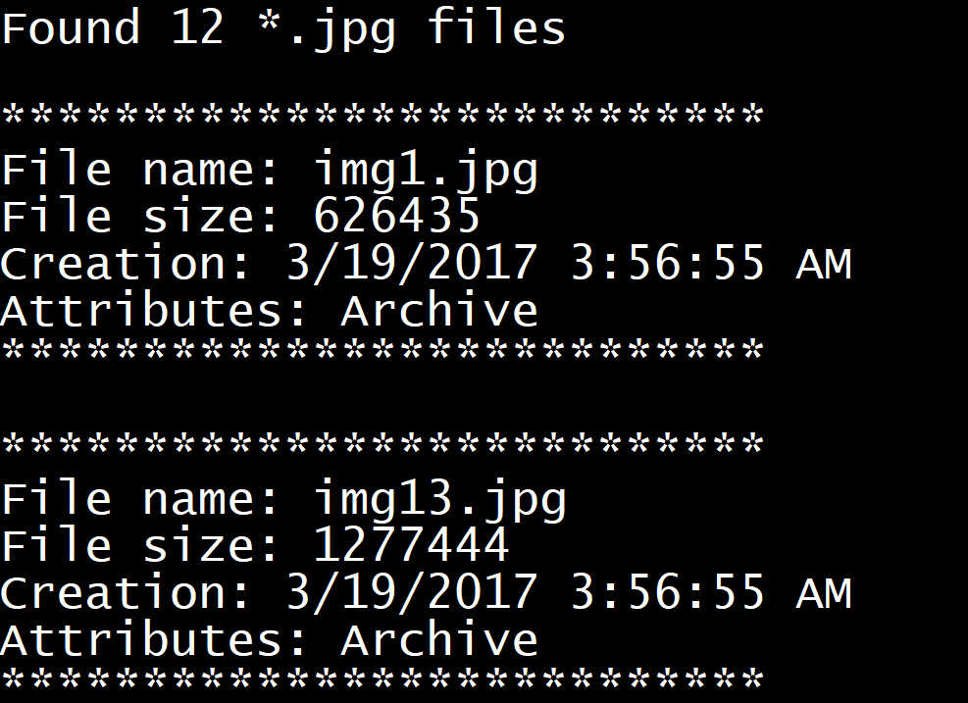
Sample 2 output

Slide 14
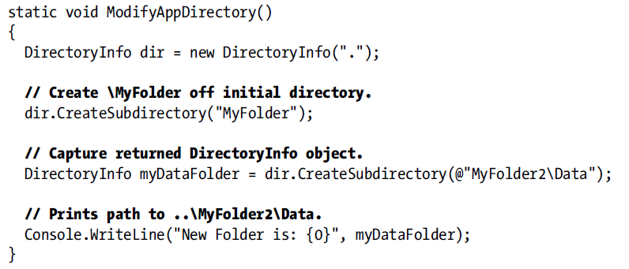
Sample 3: Manipulating directories

Slide 15
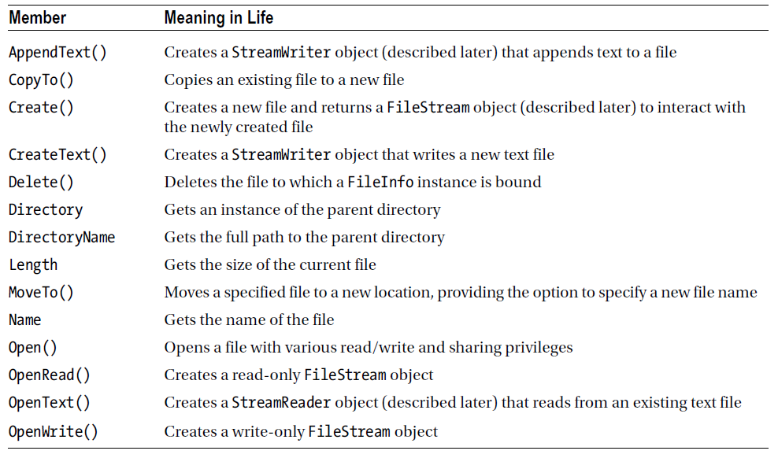
FileInfo class

Slide 16
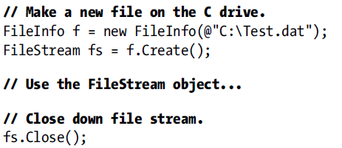
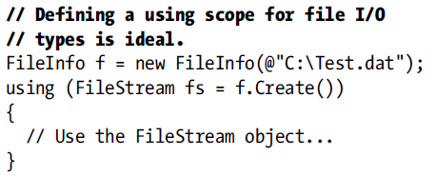
Creating and opening a file
Two ways
Method 2 is much better
Method 1
Method 2

Slide 17
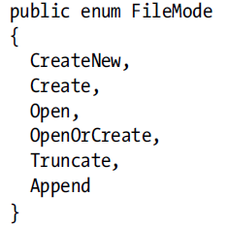
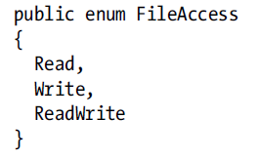
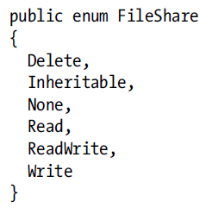
Opening an existing file
FileStream fStream = File.Open(@"myMessage.dat",
FileMode.Create,
FileAccess.ReadWrite,
FileShare.None))
See MSDN https://msdn.microsoft.com/en-us/library/system.io.fileinfo.open(v=vs.110).aspx

Slide 18
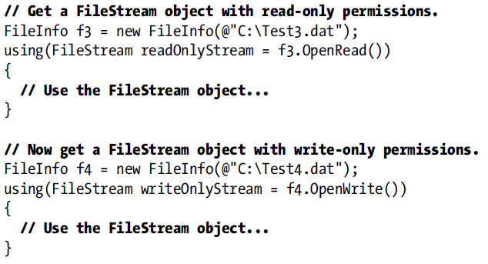
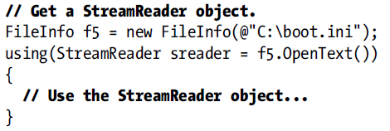
Other ways to open file
Open file for read only access
Open file for write only access
Open file to read text

Slide 19
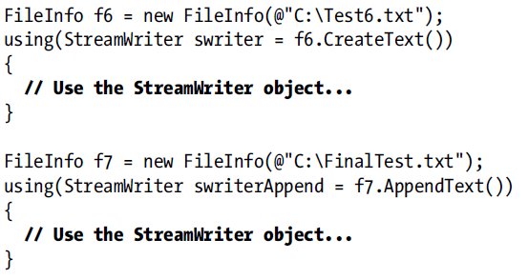
Open file to write text

Slide 20
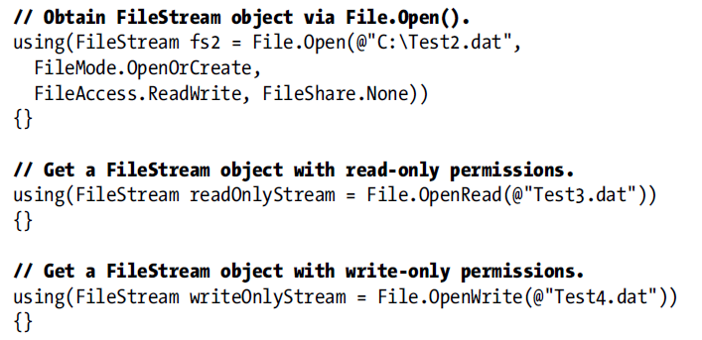
File vs FileInfo
FileInfo: requires instantiation
File: access via static methods

Slide 21
Notes
DirectoryInfo and FileInfo’s buffer are created at the creation time. When querying changing properties such as file size, access time…, calling Refresh() is necessary to get updated result

Slide 22
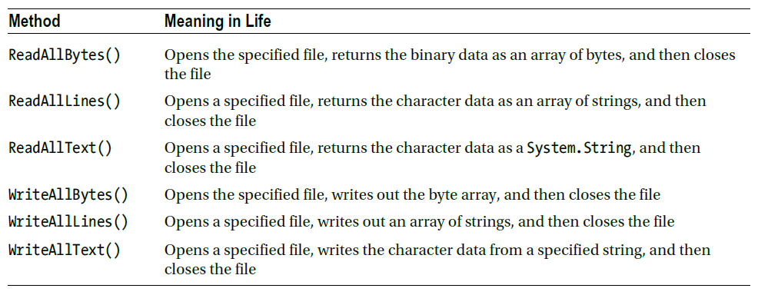
Some useful File methods

Slide 23
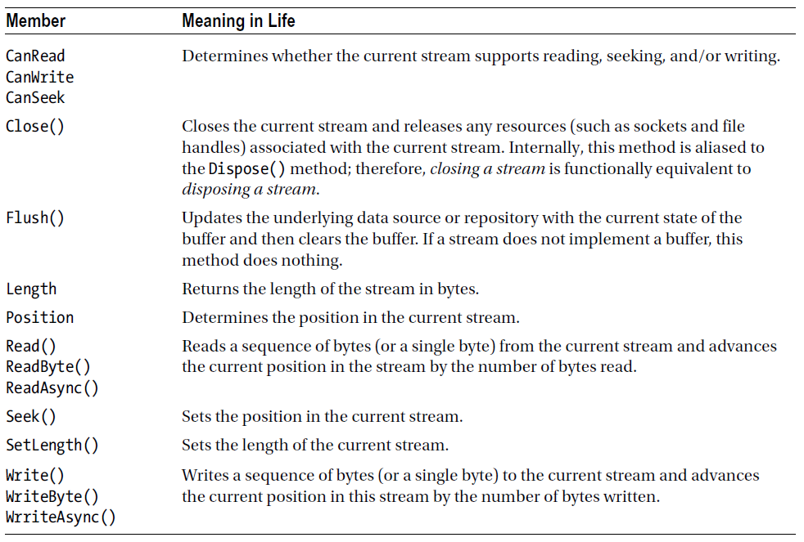
The abstract stream object

Slide 24
FileStream
Derived from Stream to read/write bytes from/to file
➔ require conversion from byte or byte array to other data type if necessary
Sample: FileStream

Slide 25
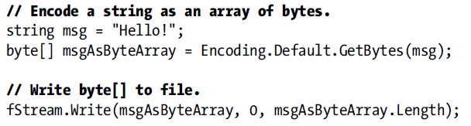
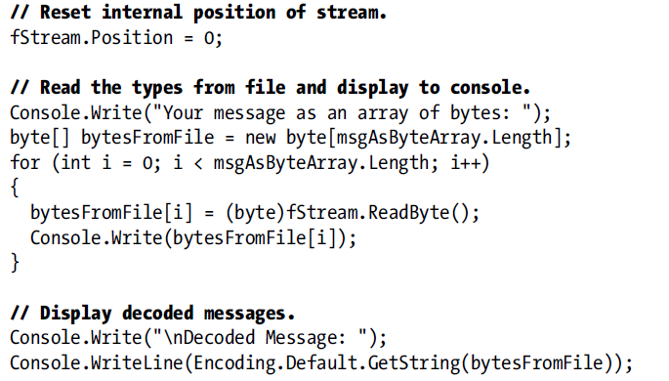
Sample: FileStream

Slide 26
StreamWriter/StreamReader
Similar to FileStream, work on text data type
Sample: StringReaderWriter
using (StreamWriter writer = File.CreateText("reminders.txt"))
{
writer.WriteLine("Đừng quên ngày thi học kỳ...");
for (int i = 0; i < 10; i++)
writer.Write(i + " ");
// Insert a new line.
writer.Write(writer.NewLine);
}

Slide 27
Special classes: StringReader/StringWriter
Similar to StreamReader/StreamWriter
Work with in-memory data, not file

Slide 28
BinaryWriter/BinaryReader
Work with binary file
Read/write binary data and convert to specific types if necessary
using (BinaryWriter bw = new BinaryWriter(f.OpenWrite()))
{
double aDouble = 1234.67;
int anInt = 34567;
string aString = "A, B, C";
// Write the data
bw.Write(aDouble);
bw.Write(anInt);
bw.Write(aString);
}

Slide 29
Object serialization
When object sharing/persisting is required
Distributed system, remote function call
App tombstoning → saving object to disk
Object needs to be serialized/deserialized

Slide 30
Object serialization
Original object
Binary/Text stream
Serializing
Persisting
Storage
Reconstructed object
Binary/Text stream
Serializing
Loading

Slide 31
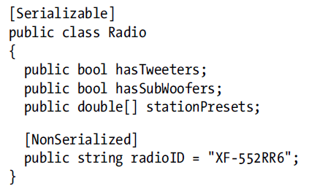
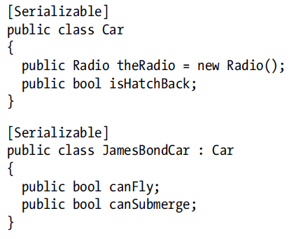
Defining object for serialization
Decorate the class/struct with [Serializable]/[NonSerialized]

Slide 32
Choosing serializer
.Net provides 3 serializer
BinaryFormatter: binary stream output
SoapFormatter: text stream output as a SOAP message
XmlSerializer: text stream output, XML standard
Binary and Soap: serializing all object members (except NonSerialized)
Xml: only serializing public members, private members needs to be exposed via public properties.

Slide 33
Serializing object
→ Similar for SoapFormatter and XmlSerializer
// Save object to a file named CarData.dat in binary.
BinaryFormatter binFormat = new BinaryFormatter();
using (Stream fStream = new FileStream(fileName,
FileMode.Create, FileAccess.Write, FileShare.None))
{
binFormat.Serialize(fStream, objGraph);
}

Slide 34
Deserializing object
BinaryFormatter binFormat = new BinaryFormatter();
using (Stream fStream = File.OpenRead(fileName))
{
JamesBondCar carFromDisk =
(JamesBondCar)binFormat.Deserialize(fStream);
Console.WriteLine("Can this car fly? : {0}", carFromDisk.canFly);
}

Slide 35
Topic for next class
Garbage collection

